Slide 1

Organizational Behavior
(MGT-502)
Lecture-36

Slide 2
Summary of
Lecture-35

Slide 3
Human Resource Policies and Practices

Slide 4
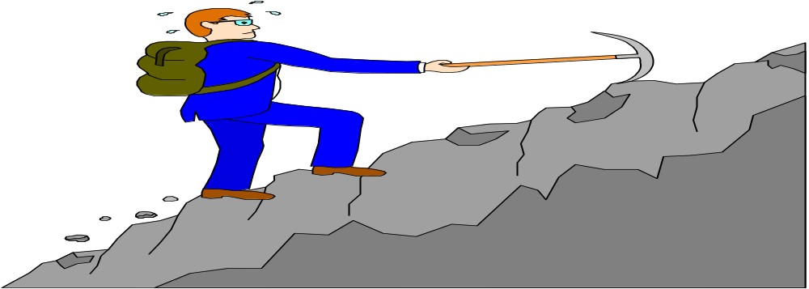
Career

Slide 5
Performance

Slide 6

Performance Appraisal

Slide 7
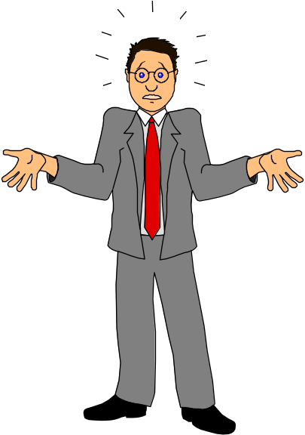
Common Rater Errors in PA’s

Slide 8
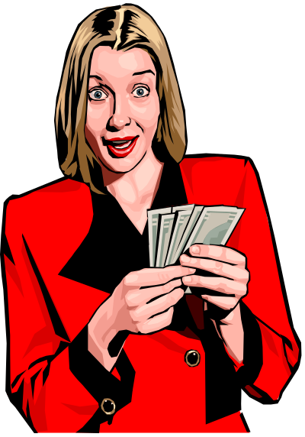
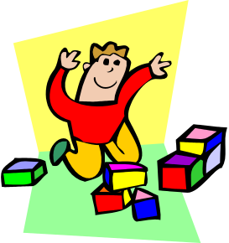
Employee Compensation

Slide 9
Pay-for-Performance

Slide 10
Today’s Topics

Slide 11

Organizational Culture

Slide 12
Organizational Culture Is
“The set of shared, taken-for-granted implicit assumptions that a group holds and that determines how it perceives, thinks about, and reacts to its various environments.”
- Edgar Schein

Slide 13
Organizational Culture?
A common perception held by the organization’s members; a system of shared meaning
  Shared things
  Shared sayings
  Shared doings
  Shared feelings

Slide 14
Culture is a Descriptive Term
Culture is composed of perceptions- how employees see their organization

Slide 15
Definition of Organizational Culture
Organizational Culture is the set of values, often taken for granted, that help people in an organization understand which actions are considered acceptable and which are considered unacceptable.
Values are often communicated through stories and other symbolic means.

Slide 16
Do Organizations have Uniform Cultures?
  Dominant culture
  Subculture
  Core values

Slide 17
Dominant culture expresses core values shared by majority
Subcultures mini-cultures within an organization, typically defined by department designations and geographically separation and tend to develop in large organizations
Core Values or dominant (primary) values are accepted throughout organization

Slide 18
Strong/Weak Cultures
Strong culture
Culture in which the core values are intensely held and widely shared

Slide 19
Benefits of Strong Corporate Cultures
Social
Control
Strong
Organizational
Culture
Social
Glue
Aids
Sense-Making

Slide 20
What Do Cultures Do?
Culture’s Functions:
Defines the boundary between one organization and others.
Conveys a sense of identity for its members.
Facilitates the generation of commitment to something larger than self-interest.
Enhances the stability of the social system.

Slide 21
What Do Cultures Do?
Culture as a Liability:
Barrier to change
Barrier to diversity
Barrier to acquisitions and mergers

Slide 22
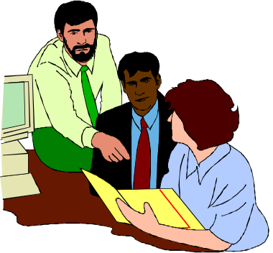
Organizational Culture and its Effects
Since organizational culture involves shared expectations, values, and attitudes, it exerts influence on individuals, groups, and organizational processes.

Slide 23
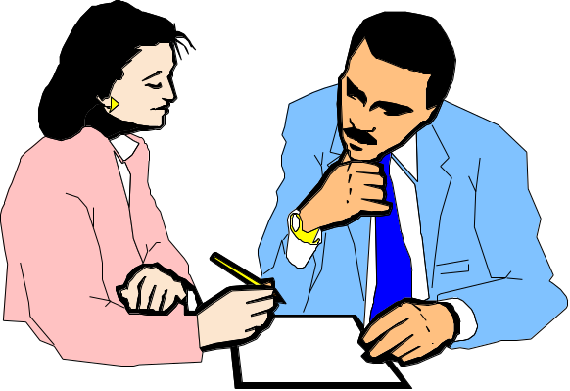
Socialization and Culture
Socialization
  Socialization is the process by which organizations bring new employees into the culture.

Slide 24
Stories
Rituals
How Employees
Learn Culture
Language
Material
Symbols

Slide 25
Components of Organizational Culture
Routine behaviors.
Norms shared by teams.
Dominant values.
Guiding philosophy for policies toward employees and customers.
The rules of the game for getting along in the organization.
The climate of the organization.

Slide 26
Dimensions of Culture
Innovation
Stability
People orientation
Outcome orientation
Easygoingness
Detail orientation
Team orientation

Slide 27

Dimensions of Culture
Communications
Training & Development
Rewards
Decision-making
Risk taking
Planning
Teamwork
Management practices

Slide 28
Functions of Culture
Supports the organization’s business strategy.
Prescribes acceptable ways for managers to interact with external constituencies.
Makes staffing decisions.
Sets performance criteria.
Guides the nature of acceptable interpersonal relationships in the company.
Selects appropriate management styles.

Slide 29
Four Functions of Organizational Culture
Organizational
identity
Sense-making
device
Collective
commitment
Organizational
culture
Social system
stability

Slide 30
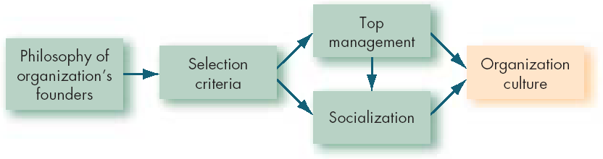
How Organization Cultures Form

Slide 31
How to Create a Culture
Develop shared assumptions.
Formulate assumptions.
Develop values.
Reflect assumptions and values in artifacts.
Most likely top-down initiated, but can be employee- or team-initiated.

Slide 32
The Bottom Line: Developing an Effective Organizational Culture
Develop a
Mission
Statement for
the Firm
Formulate Strategic
Objectives to
Support the
Mission
Identify the Core
Values and
Operating Principles
That Support the
Mission and Strategic
Objectives
Socialize New
Employees into the
Culture of the Firm
Hire New
Employees Who
Are Compatible with
the Firm’s Culture
Develop Formal
Mechanisms for
Communicating
the Elements of the
Culture to Employees

Slide 33
Keeping Culture Alive
Selection
  Concerned with how well the candidates will fit into the organization.
  Provides information to candidates about the organization.
Top Management
  Senior executives help establish behavioral norms that are adopted by the organization.
Socialization
  The process that helps new employees adapt to the organization’s culture.

Slide 34
Five Most Important Elements in Managing Culture
What leaders pay attention to
How leaders react to crises
How leaders behave
How leaders allocate rewards
How leaders hire and fire individuals

Slide 35
Strengthening Organizational Culture
Founders
and leaders
Strengthening
Organizational
Culture
Selection
and
socialization
Culturally
consistent
rewards
Managing the
cultural
network
Stable
workforce

Slide 36
Embedding Organizational Culture
Formal statements of organizational philosophy, mission, vision, values, and materials used for recruiting, selection and socialization
The design of physical space, work environments, and buildings
Slogans, language, and sayings
Deliberate role modeling, training programs, teaching and coaching by managers and supervisors
Explicit rewards, status symbols (e.g., titles), and promotion criteria
Stories, legends, and myths about key people and events

Slide 37
The organizational activities, processes, or outcomes that leaders pay attention to, measure, and control
Leader reactions to critical incidents and organizational crises
The workflow and organizational structure
Organizational systems and procedures
Organizational goals and the associated criteria used for recruitment, selection, development, promotion, layoffs, and retirement of people

Slide 38
How to Change a Culture
If the culture no longer supports the goals and strategy of an organization, it should be changed.
Mergers and acquisitions generally result in a change in culture.

Slide 39
Requirements for Successfully Changing Organizational Culture
Understand the old culture first.
Support employees and teams who have ideas for a better culture and are willing to act on those ideas.
Find the most effective subculture in the organization and use it as a model.
Help employees and teams do their jobs more effectively.
Use the vision of a new culture as a guide for change.
Recognize that significant cultural change takes time.

Slide 40
So What????
Organizational culture matters!!
  Some firms are ethical
  Some firms value people
  Some firms like to work
  Some places value rules, status
  Employees behave differently

Slide 41
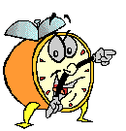
Let’s stop it here

Slide 42
Summary

Slide 43
Organizational Culture

Slide 44
Stories
Rituals
How Employees
Learn Culture
Language
Material
Symbols

Slide 45
Four Functions of Organizational Culture
Organizational
identity
Sense-making
device
Collective
commitment
Organizational
culture
Social system
stability

Slide 46
Next….

Slide 47
Organizational Behavior
(MGT-502)
Lecture-36

